Slide 1

NIIS INSTITUTE OF BUSINESS ADMINISTRATION
PROJECT
ON
“MAKE MY TOUR”
Under the Guidance Of:
Prof. ..........................
Presented by-
Mr/MISS. .............
Reg. No...............

Slide 2
TOPIC OUTLINES
Introduction
Project Abstract
Objective
Problem Statement
Proposed Solution
Proposed system
Expected Benefits
Modules
Software & hardware
E-R diagram
DFD
Site Map
Future scope
Conclusion
Reference

Slide 3
INTRODUCTION
In software industry requirement engineering is one of the most important parts of software engineering process, which one gives us the proper scenarios what the customers want, analyzing their needs and checking the feasibility what they need, negotiating a reasonable solution etc. In software industries, a software project begins when a business need is identified. So the first step is we need to understand the customer needs. Figure out a rough feasibility analysis, not only the customer’s need but also with the people who are apparently involved with the introducing system. In this phase we get some requirement for online inventory system.
Make My Tour is fully integrated, which means users are able to work more efficiently and management decision making. Software Solutions is an IT solution provider for a dynamic environment where business and technology and end users strategies converge. Their approach focuses on new ways of business combining tour innovation and adoption while also leveraging an organization’s current manual tour.

Slide 4
ABSTRACT
This project is aimed at developing web based MAKE MY TOUR for customers who wants to travels tourism place worldwide. This MAKE MY TOUR project can be used to store the details of the customers, update the packages based on the customer demand, produce money receipts for customers, generate different reports etc. This is one integrated system that contains both the user component (used by customers, advertise company etc) and the admin component (used by the administrators for performing admin level functions such as adding new category to the tour, adding new subcategory, adding new package, changing the price of package, produce report etc.)This system runs on multiple terminals, offers a GUI interface to its users and connects to a common database(s).Since it is a web based application the Administrators or any high level authority can track details about the customer’s booking reports , monthly expenses etc. In addition to this admin can generate various reports on the basis of daily, monthly or yearly, which acts as important instruments for taking proper decision towards the benefit of tour business and to meet current tour business challenges. This system provides beautiful and clear interfaces for easy use of system.

Slide 5
OBJECTIVE
The Make My Tour will fulfil the following objectives:
Features to facilitate entry and update of package, category, subcategory and view enquiry details..
Tracking of customers/visitors contact information
Tracking of booking details of customers/visitors.
The customers can view or find the information of tourist attraction.
The customers can search for booking tour place time to go in advance.
Facility to generate an invoice by administrator.
Alerts for the booking reorder of customer

Slide 6
PROBLEM STATEMENT
1. The customers/visitors need to ask information and review immediately to make sure that what place they should go.
2. Application or website that include with travel agency such as trip advisor usually use simple Forum.
3. The information of maps that have download to use with no internet connection may be wrong and not enough for customers demand.
4. About how to go with different transportation, ways to go, price that have to manage, and who that customers go with.
5. The search with stronger type such as when customers/visitour want to with family and their pets, what place that they should go.
6. With history of systems maybe tell customers/visitors just place that they go.
7. In nowadays, with many social network such as Facebook and line have function about travel but they doesn't have function agency inside.
8. Different place different language, If foreigner ask about information and how to go in the local area what should customers do.

Slide 7
PROPOSED SOLUTION
To debug the existing system, remove procedures those cause data redundancy, make navigational sequence proper. To provide information about users on different level and also to reflect the current work status depending on customers/visitors.

Slide 8
EXPECTED BENEFITS
The Make My Tour will bring a number of benefits to the customers/visitors:
The system will help to keep accurate records of tour for visitors.
The maintenance of accurate records should reduce misappropriation.
The customers can view or find the information of tourist attraction.
The customers can search for booking tour place time to go in advance.
The customers can find the information and the calculate system of time, ways, price to the destination place.
The customers can review place or find another friends and people reviews.
The customers can see private history with analyse with booking, transport, price, time, etc. And keep or share the information.
The customers can use function dictionary to translate sentences for communication with different language of travellers.
The customers can note with text or plan trip with themselves.
The customers can find the location themselves and share location if they want.
The customers can see whether of each area inside map or place that they want to go with Google map detection.
The customers can view different package photo using website.

Slide 9
MODULES
This project is aimed at developing an online Inventory Management System for a departmental store.
The Project has the following modules
Admin
Visitor
The administrator should be able to
Login to the system and change his password after logging in.
Add, update, and delete users to the system.
Add, update, and delete categories.
Add, update, and delete subcategory.
Add, update, and delete packages.
Inquiry Confirmation of visitors.
Generates reports.
Checking billing activity.

Slide 10

MODULES
A Visitors should be able to
A visitor can visit website.
Visitor can check all categories with its sub category and its packages.
Visitors can send suitable inquiry when they want to visit the place.

Slide 11
SOFTWARE & HARDWARE
Software Requirements:
Name of component Specification
Operating System Windows7,Windows 10, Linux
Language PHP
Database MySQL
Browser Mozilla, Opera, Chrome
Web Server Tomcat
Hardware Requirements:
Name of component Specification
Processor Core i3 and above
RAM 2GB
Hard disk 256 GB
Monitor 15” color monitor
Keyboard 122 keys

Slide 12
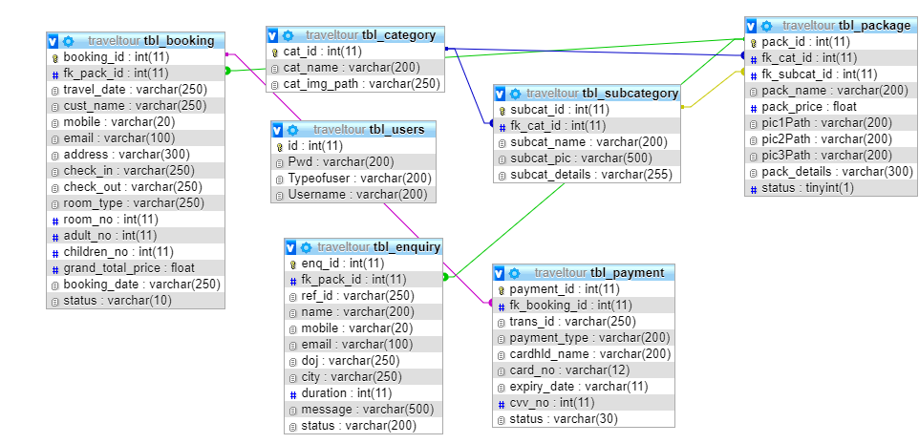
ER DIAGRAM

Slide 13
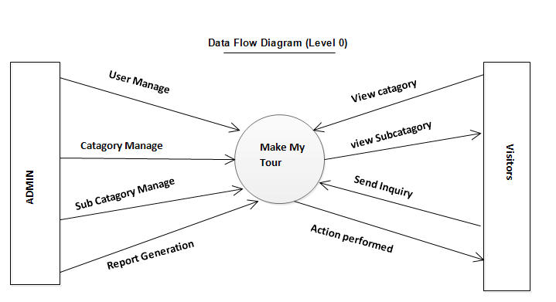
DATA FLOW DIAGRAM

Slide 14
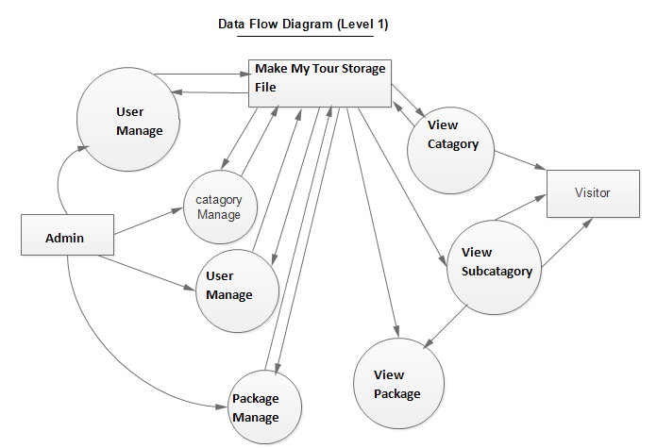
LEVEL - 1

Slide 15
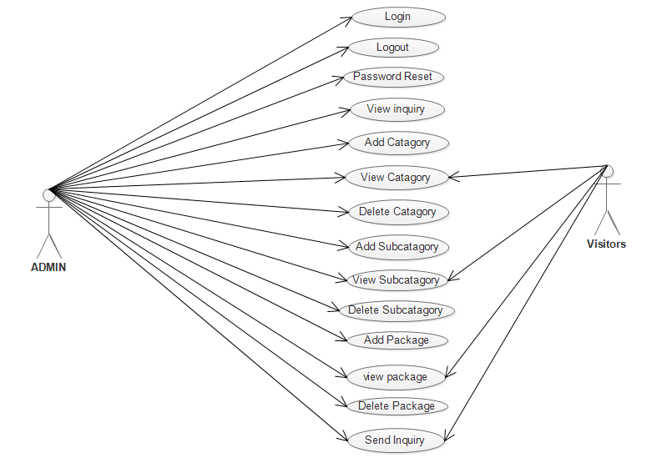
USE CASE DIAGRAM

Slide 16
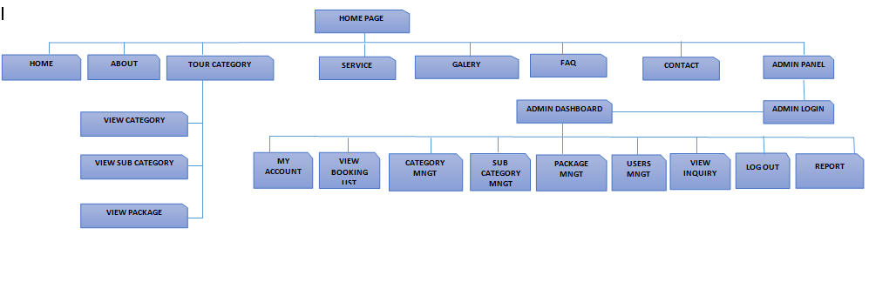
SITE MAP

Slide 17
FUTURE SCOPE
It is not possible to develop a system that makes all the requirements of the user. User requirements keep changing as the system is being used. Some of the future enhancements that can be done to this system are:
1. As the technology emerges, it is possible to upgrade the system and can be adaptable to desired environment.
2. Because it is based on object-oriented design, any further changes can be easily adaptable.
3. Based on the future security issues, security can be improved using emerging technologies.
4. sub admin module can be added

Slide 18
CONCLUSION
The “Make My Tour” was successfully designed and is tested for accuracy and quality. During this project we have accomplished all the objectives and this project meets the needs of the organization. The developed will be used in searching, retrieving and generating information for the concerned requests.
GOALS
1. Reduced entry work
2. Making Tour booking is very easy and fast with effective manner.
3. Most Secure web application.
4. Easy retrieval of information
5. Reduced errors due to human intervention
6. User friendly screens to enter the data
7. Portable and flexible for further enhancement
8. Web enabled.
9. Fast finding of information requested

Slide 19
BIBLIOGRAPHY
For Java installation
https://www.oracle.com
For MySql Database installation
https://dev.mysql.com/downloads/mysql/
For Server(Apache Tomcat) installation
https://tomcat.apache.org/download-90.cgi
Reference websites
www.javatpoint.com
www.w3schools.com
Reference Books
Complete reference Java
Thinking in java
Java Black Book J2EE

